Slide 1

TAAF: A Trace Abstraction and Analysis Framework Synergizing Knowledge Graphs and LLMs
Dec 5
Alireza Ezaz

Slide 2
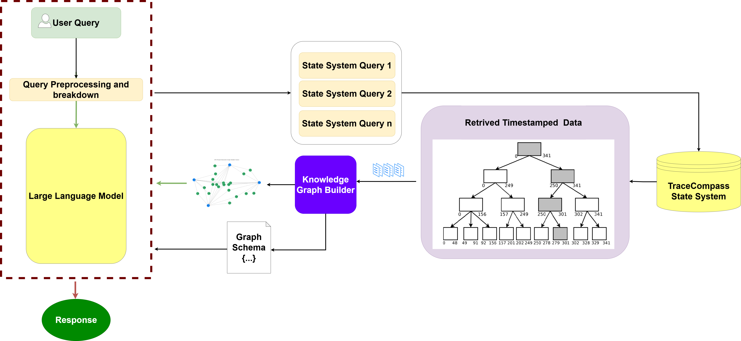
Methodology Architecture
2 / 20

Slide 3
Research Questions
RQ1: To what extent does the incorporation of a Knowledge Graph improve the accuracy of the TAAF when answering trace-related queries?
RQ2: Does providing the LLM with the graph schema (node types and features) enhance the accuracy of its responses?
RQ3: How does the accuracy and quality of TAAF responses vary across different LLM models (GPT-4 .1 nano (small), GPT-4o, o4-mini (Reasoning))?
RQ4: What is the effect of time interval length on the performance of TAAF's answers?
RQ5: How does TAAF's accuracy vary across different query types (e.g., multiple-choice, true/false, explanatory), and graph structures (single-hub vs. multi-hub)?
RQ6: To what extent does the choice of temporal location (early vs. late in the trace) affect system performance and reasoning accuracy?
RQ7: How does the temperature (sampling randomness) parameter affect the accuracy and consistency of LLM responses within TAAF?
3 / 20

Slide 4
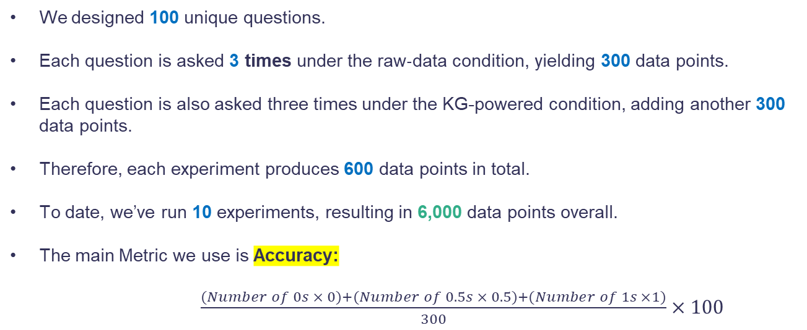
Approach
We designed 100 unique questions.
Each question is asked 3 times under the raw‐data condition, yielding 300 data points.
Each question is also asked three times under the KG-powered condition, adding another 300 data points.
Therefore, each experiment produces 600 data points in total.
To date, we’ve run 10 experiments, resulting in 6,000 data points overall.
The main Metric we use is Accuracy:
$\frac{(Number of 0s × 0)+(Number of 0.5s × 0.5)+(Number of 1s ×1)}{300}×100$
4 / 20
Notes:
Accuracy=3000.5×#0.5+1×#1​×100

Slide 5
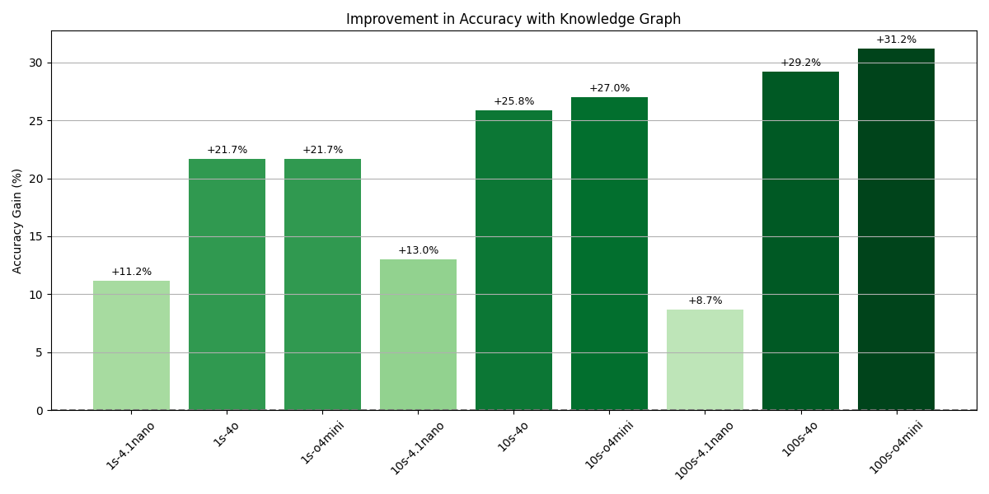
RQ1: To what extent does the incorporation of a Knowledge Graph improve the accuracy of the TAAF when answering trace-related queries?
Min Improvement: +8.7%
Max Improvement: + 31.2%
Average Improvement: +21.5%
6 / 20
Notes:
# Compute average scores df['Avg_no_graph'] = (df['0s_no_graph'] * 0 + df['0.5s_no_graph'] * 0.5 + df['1s_no_graph']) / 300 df['Avg_graph'] = (df['0s_graph'] * 0 + df['0.5s_graph'] * 0.5 + df['1s_graph']) / 300 df['Acc_no_graph'] = df['Avg_no_graph'] * 100 df['Acc_graph'] = df['Avg_graph'] * 100 df['Accuracy_Improvement (%)'] = df['Acc_graph'] - df['Acc_no_graph’]
The longer thr interval. The longer it helps

Slide 6
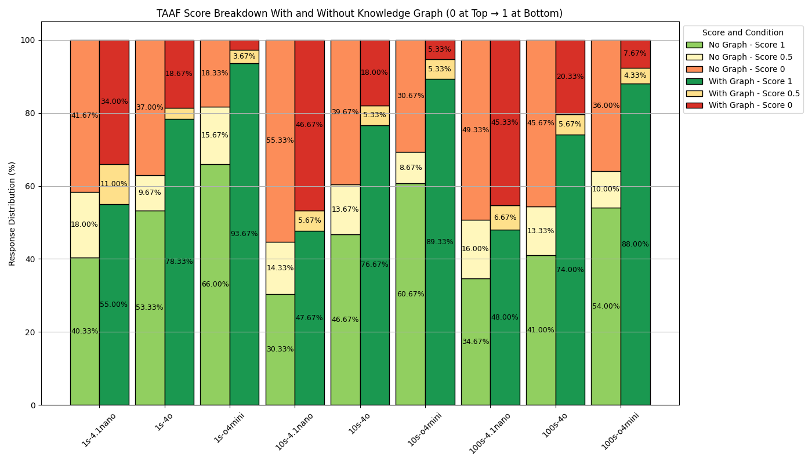
RQ1: To what extent does the incorporation of a Knowledge Graph improve the accuracy of the TAAF when answering trace-related queries?
6 / 16

Slide 7
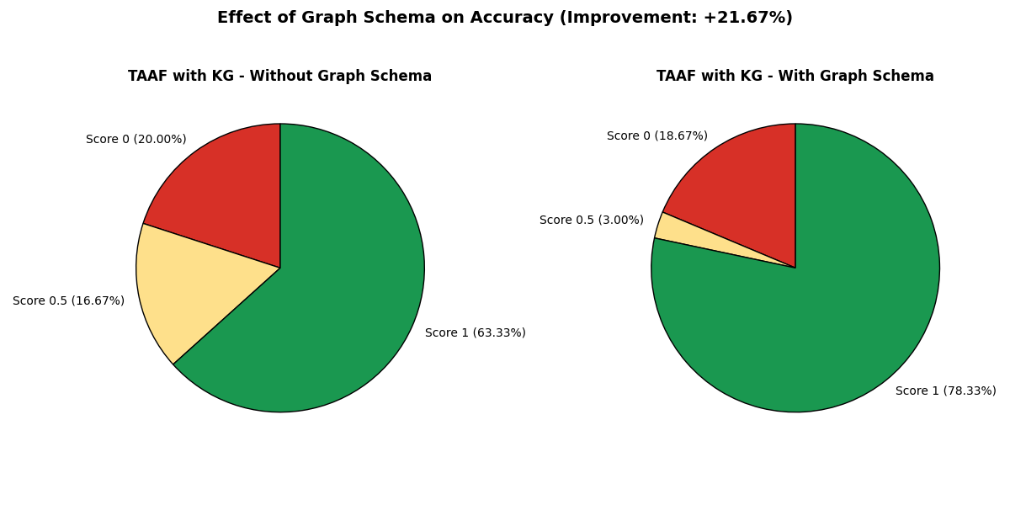
RQ2: Does providing the LLM with the graph schema (node types and features) enhance the accuracy of its responses?
Experiment was done on 1s of data from the mid timestamp with 4o model
+21.67% Improvement
7 / 20

Slide 8
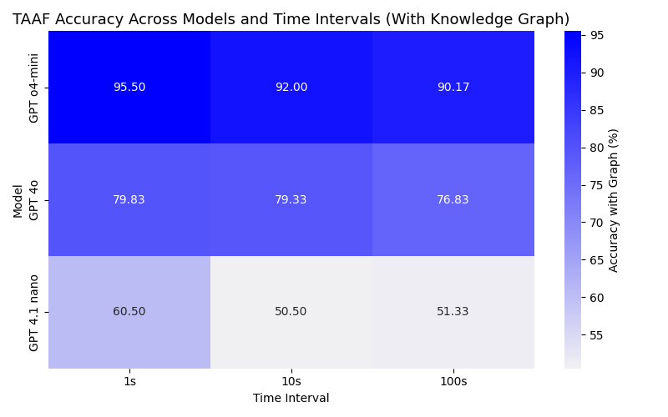
RQ3: How does the accuracy and quality of TAAF responses vary across different LLM models (GPT-4 .1 nano (small), GPT-4o, o4-mini (Reasoning))?
Min Accuracy: 50.50
Max Accuracy: 95.50
8 / 20

Slide 9
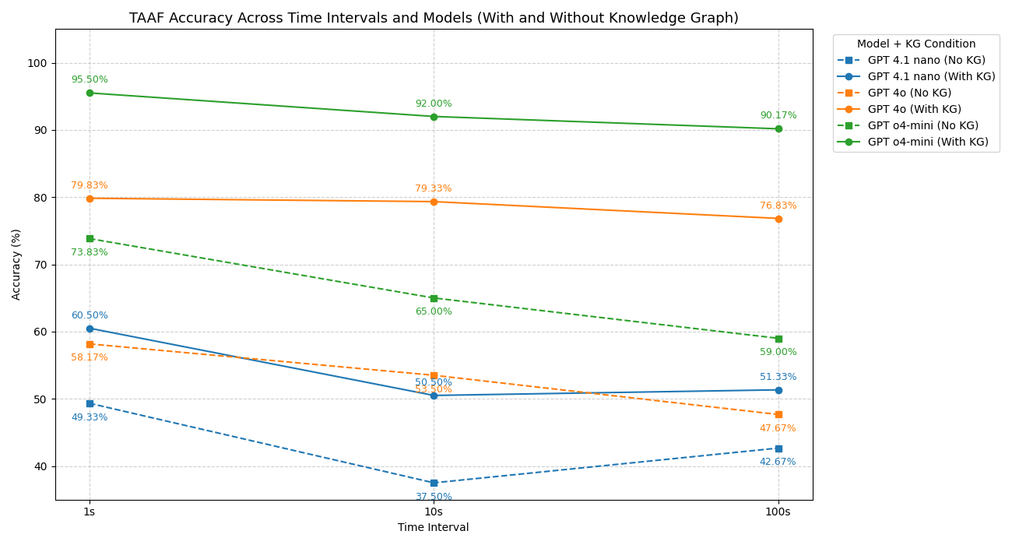
RQ4: What is the effect of time interval length on the performance of TAAF's answers?
9 / 20

Slide 10
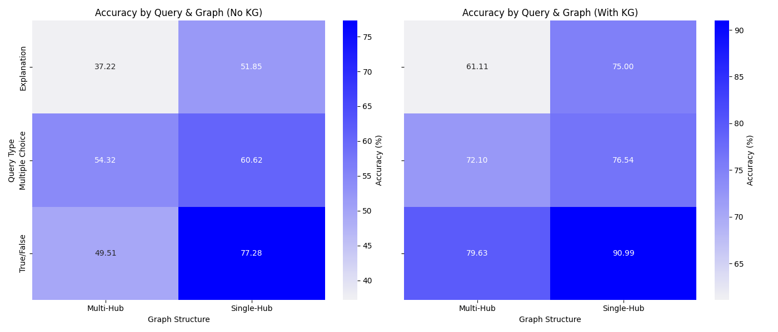
RQ5:How does TAAF's accuracy vary across different query types (e.g., multiple-choice, true/false, explanatory), and graph structures (single-hub vs. multi-hub)?
Note: Aggregated results across all models
TAAF Best Accuracy: True/False Single-Hub 90.99%
TAAF Worst Accuracy: Explanation Multi-Hub 61.11%
10 / 20

Slide 11
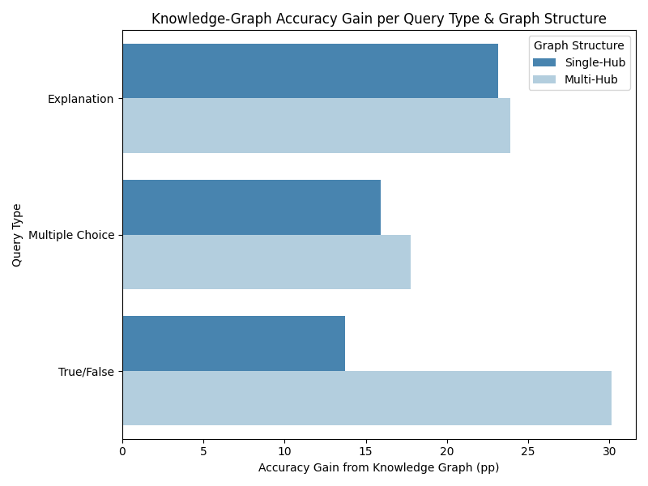
RQ5:How does TAAF's accuracy vary across different query types (e.g., multiple-choice, true/false, explanatory), and graph structures (single-hub vs. multi-hub)?
Note: Aggregated results across all models
TAAF Best Accuracy Gain: True/False Multi-Hub 30%
11 / 20

Slide 12
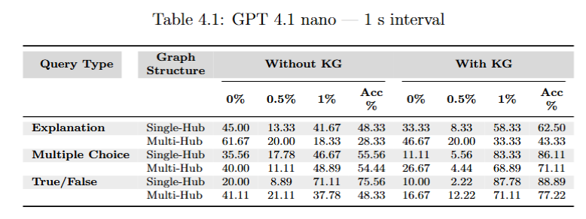
RQ5:How does TAAF's accuracy vary across different query types (e.g., multiple-choice, true/false, explanatory), and graph structures (single-hub vs. multi-hub)?
12 / 20

Slide 13
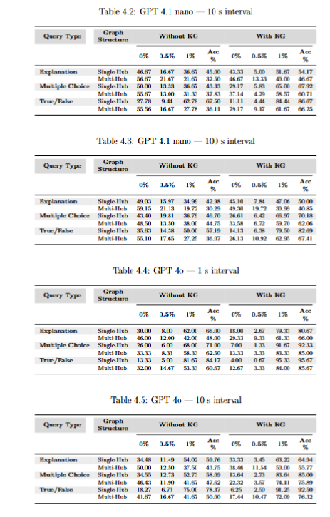
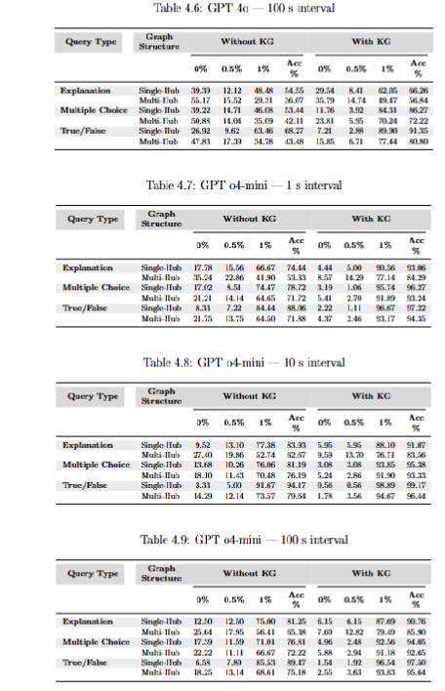
RQ5:How does TAAF's accuracy vary across different query types (e.g., multiple-choice, true/false, explanatory), and graph structures (single-hub vs. multi-hub)?
13 / 20

Slide 14
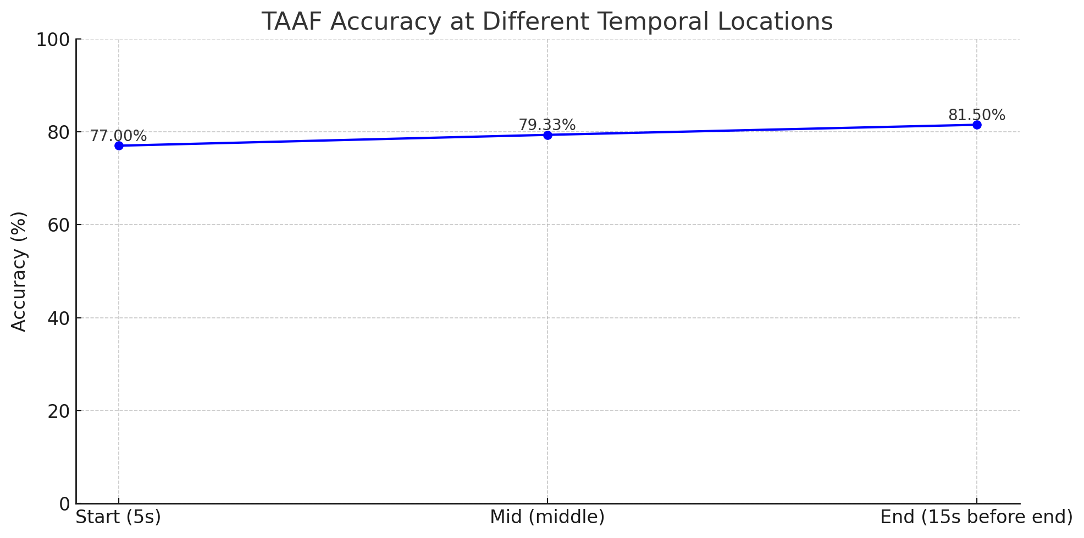
RQ6: To what extent does the choice of temporal location (early vs. late in the trace) affect system performance and reasoning accuracy?
14 / 20

Slide 15
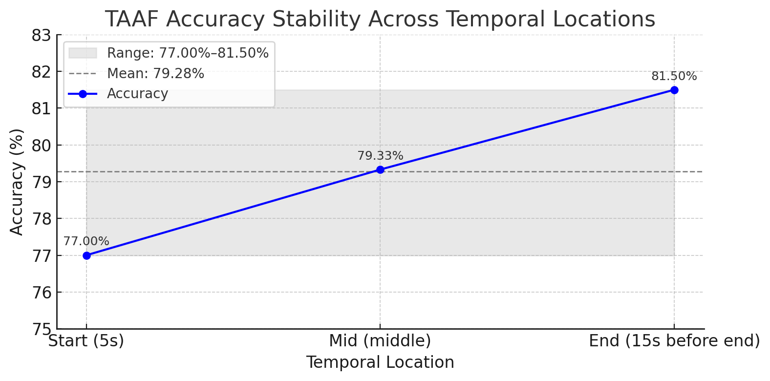
RQ6: To what extent does the choice of temporal location (early vs. late in the trace) affect system performance and reasoning accuracy?
15 / 20

Slide 16
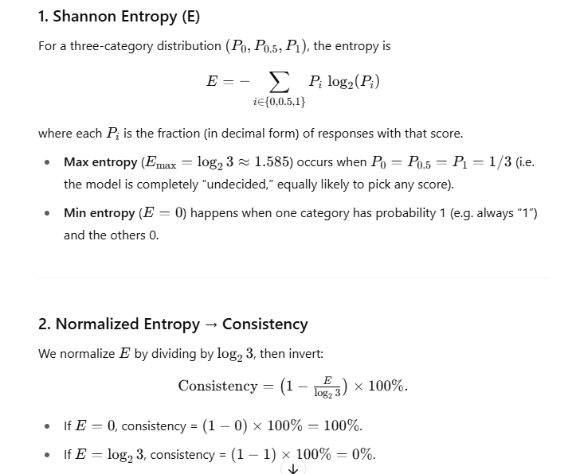
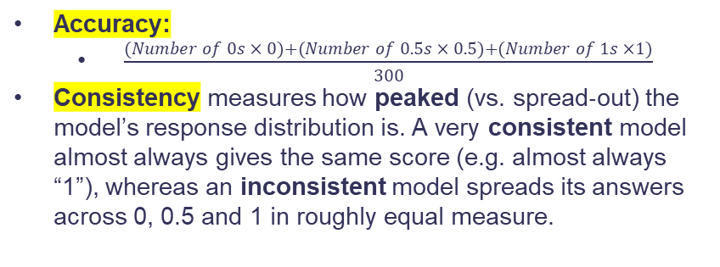
RQ7: How does the temperature (sampling randomness) parameter affect the accuracy and consistency of LLM responses within TAAF?
Accuracy:
$\frac{(Number of 0s × 0)+(Number of 0.5s × 0.5)+(Number of 1s ×1)}{300}$
Consistency measures how peaked (vs. spread‐out) the model’s response distribution is. A very consistent model almost always gives the same score (e.g. almost always “1”), whereas an inconsistent model spreads its answers across 0, 0.5 and 1 in roughly equal measure.
16 / 20

Slide 17
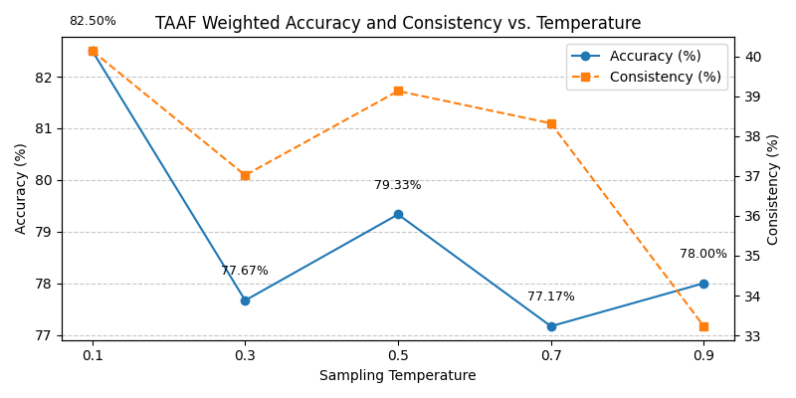
RQ7: How does the temperature (sampling randomness) parameter affect the accuracy and consistency of LLM responses within TAAF?
17 / 20

Slide 18
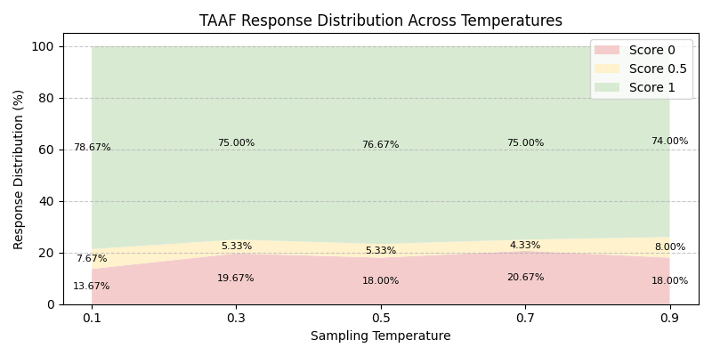
RQ7: How does the temperature (sampling randomness) parameter affect the accuracy and consistency of LLM responses within TAAF?
18 / 20

Slide 19
Future Research Questions
RQ8: How does introducing an AI agent (e.g., multi-turn dialogue, clarification loops) improve the interpretability and correctness of TAAF responses?
19 / 20

Slide 20



Thanks!
Do you have any questions?
sezaz@brocku.ca
www.linkedin.com/in/s-alireza-ezaz
20 / 20

